Slide 1
BUSINESS EXECUTIVE REPORT

Slide 2
EXECUTIVE SUMMARY
The presentation we have today is on various segments such as Government, Small businesses etc that manufactures Biro, Notepad, Markers, Pencils, Stapler and A4 Paper in the South-West Region of Nigeria.
The analysis of the data will guide us with making a decision based on which products are profitable cut across the various States and Segment.

Slide 3
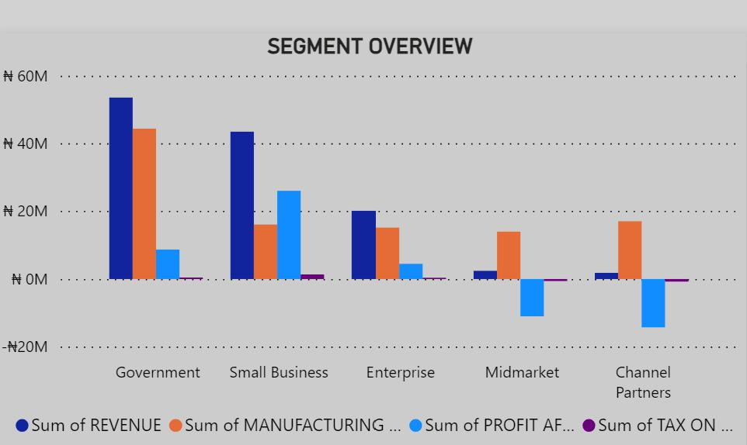
THE SEGMENTS GOVERNMENT, SMALL BUSINESS AND ENTERPRISE RECORDED THE HIGHEST REVENUES
TWO SEGMENTS (MIDMARKET AND CHANNEL PARTNERS) RECORDED LOSSES AFTER TAX
THE GOVERNMENT SECTOR GULPED THE MOST SUM IN TERMS OF MANUFACTURING BUT ALSO RETURNED THE HIGHEST IN TERMS OF REVENUE

Slide 4
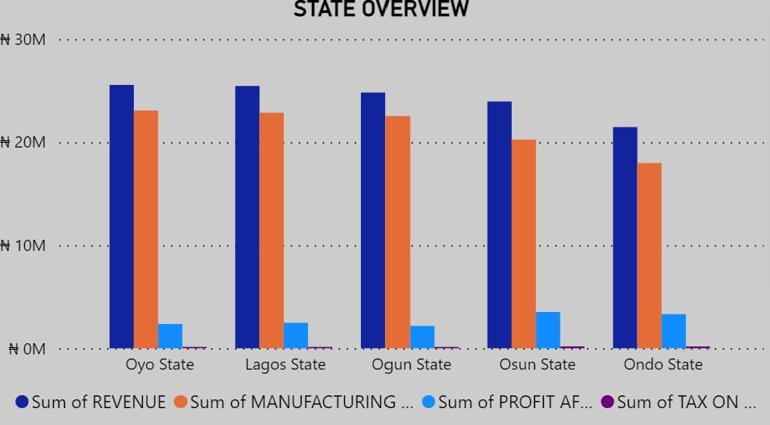
ALL STATES GENERATED OVER 20M REVENUE BUT ONDO HAD THE LEAST SUM INVESTMENT IN COST OF MANUFACTURING
OSUN RECORDED THE HIGHEST PROFIT AFTER TAX

Slide 5
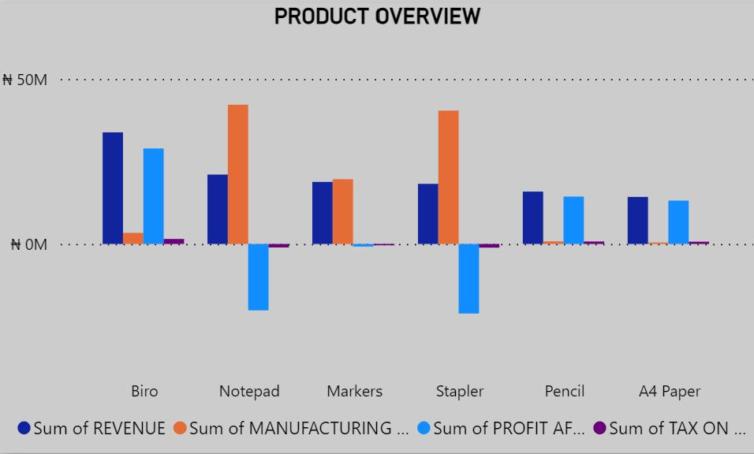
BIRO HAD THE LEAST INVESTMENT IN MANUFACTURING COST AND GENETAED THE HIGHEST REVENUE
NOTEPAD AND STAPLERS YIELDED LOSSES AFTER TAX WHICH IS NOT GOOD FOR BUSINESS
THE TOP THREE PRODUCTS IN TERMS OF MANUFACTURING COST ARE NOTEPAD, MARKERS AND STAPLERS

Slide 6
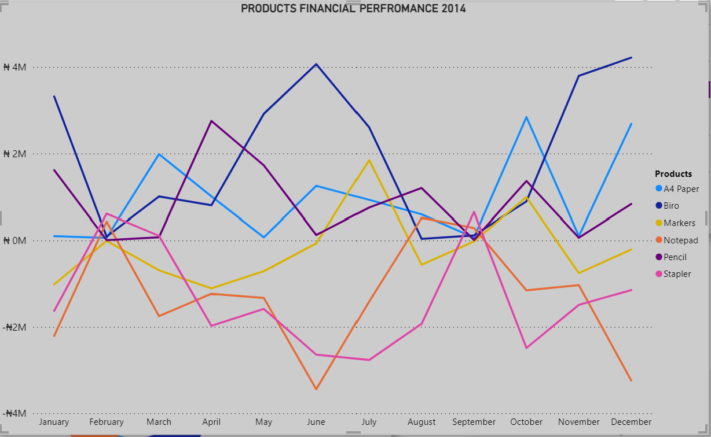
THREE PRODUCTS CLOSED THE YEAR BELOW THE PROFIT MARGIN THEREBY RECOFING LOSSES
THREE PRODUCTS FINISHED ABOVE THE PROFIT MARGIN WITH BIRO TOPPING THE CHART AT CLOSE OF YEAR

Slide 7
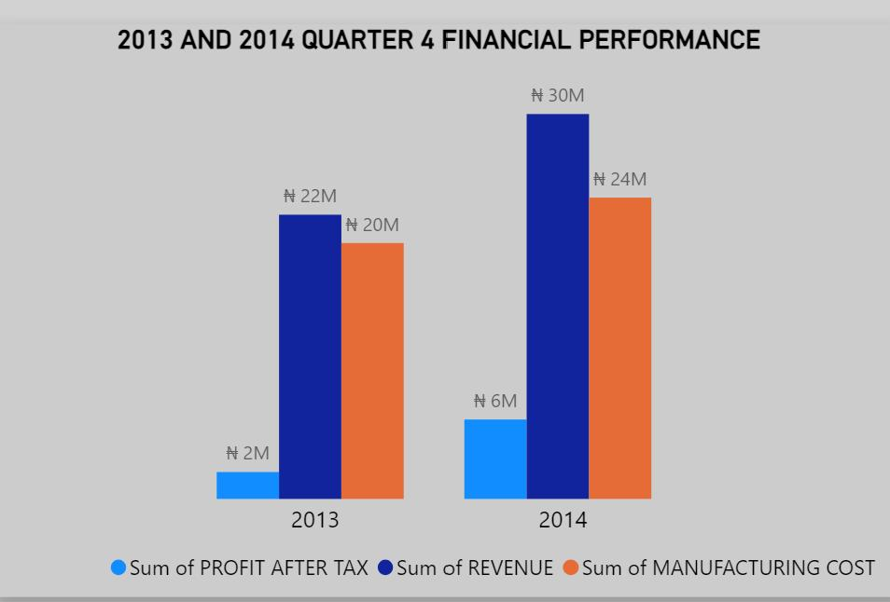
THERE WAS AN INCREASE IN REVENUE FROM THE LAST QUARTER OF 2013 AS SEEN IN QUARTER 4 OF 2014
BOTH QUARTERS SHOW A DIRECT PROPORTIONAL RELATIONSHIP BETWEEN COST OF MANUFACTURING COST

Slide 8
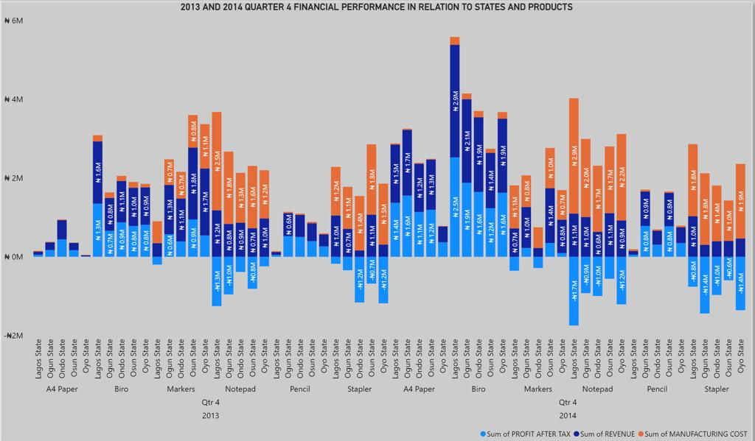
THERE WAS A SIGNIFICANT SPIKE IN REVENUE FROM BIRO SALES IN 2014 Q4 IN LAGOS
NOTEPAD AND STAPLER RECORDED LOSSES IN BOTH QUARTER 4 OF 2013 AND 2014

Slide 9
THE DRIVERS OF PERFROMANCE FOR THE COMPANY ARE A4 PAPER, PENCIL AND BIRO AS
THEY RECORDED THE MOST REVENUES WITH THE LEAST PRODUCTION COST
DUE TO THE FIGURES OBTAINED FOR THE PRODUCTS STAPLER AND NOTEPADS, THERE IS A NEED TO DISCONTINUE THEIR PRODUCTION

Slide 10
THE HIGHEST TAX PAYING PRODUCT IS BIRO

Slide 11
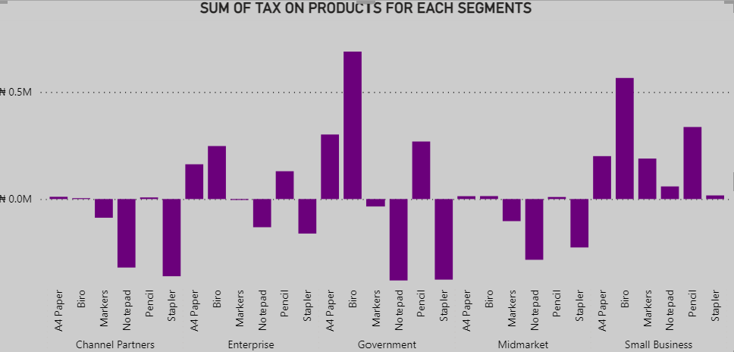
THE PRODUCT WE PAY THE HIGHEST TAX FOR EACH SEGMENT IS A4 PAPER FOR CHANNEL PARTNERS. THE HIGHEST TAX THAT WAS PAID FOR THE OTHER SEGMENTS WAS ON BIRO.

Slide 12
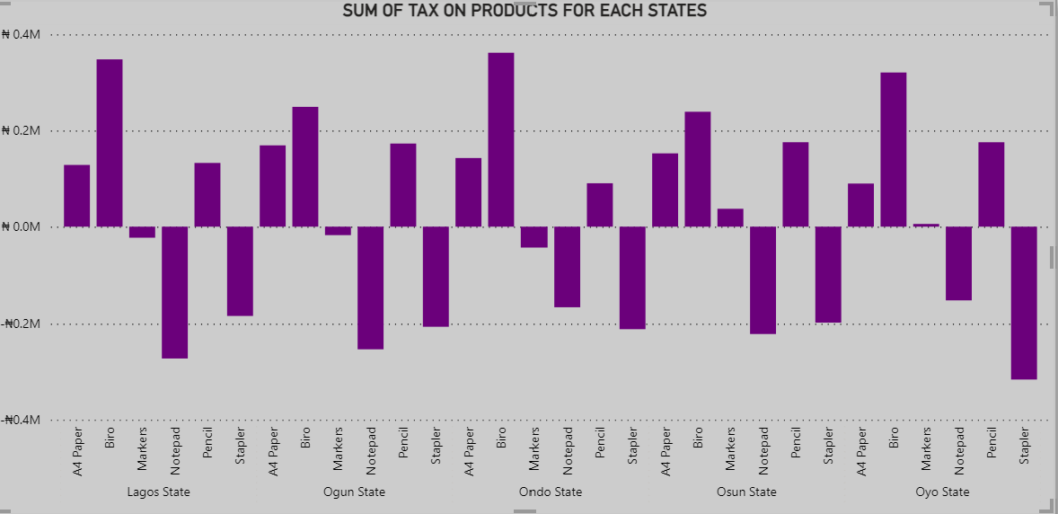
THE HIGHEST TAX PAID ACROSS ALL STATE WAS PAID ON BIRO AS IT HIGHEST GROSS PROFIT.

Slide 13
RECOMMENDATIONS
ATTENTION SHOULD BE PAID TO PRODUCTS WHICH REQUIRE LESS TO PRODUCE BUT GENERATE GOOD REVENUE
SOME STATES GENERATE PROFIT BEFORE TAX BUT LOSSES AFTER TAX. DETAILED ANALYISIS INTO WHY SHOULD BE CONDUCTED AS MULTIPLE TAXATION COULD BE A REASON
MORE PRODUCTION OUTLETS SHOULD BE SITUATED IN STATES THAT GENEREATE THE MOST REVENUE AND TAKE THE LEAST TAXES

Slide 14
CONCLUSION
The key products that are generating profits are A4 Paper, Biro and Pencil this is as result of having low manufacturing cost which could be as a result of easy access to raw materials, cheap labour especially in Ondo state.
The immediate stop to the production of Notepads and Staplers as they are making a lot of loss for the company because the manufacturing cost is too high. As for the production of Markers, there has to be a drastic reduction in the manufacturing cost and not give up on it as it made profit in 2013 so there is still a possibility it can make profit, we can get cheaper raw materials and reduce labor cost which will help in reducing the manufacturing cost.
The small businesses have the highest profits in the various Segments and the government can also assists the small business by giving them the opportunity to have more grants that will be used to expand their business leading to more tax paid to the government.

Slide 15
THANK YOU

